Slide 1

CS411-Compiler Construction
Top Down Parsing
-Recursive Descent Parsing
-Recusrive Predictive Parsing
-Non-Recursive Predictive Parsing
Talha Waheed, Dept. of CS, UET, Lahore, Pakistan.

Slide 2
Course Learning Objectives

Slide 3
Top-Down Parsing
The parse tree is created from top to bottom.
Top-down parser
Recursive-Descent Parsing
Backtracking is needed (If a choice of a production rule does not work, we backtrack to try other alternatives.)
It is a general parsing technique, but not widely used.
Not efficient
Predictive Parsing
no backtracking
efficient
needs a special form of grammars (LL(1) grammars).
Recursive Predictive Parsing is a special form of Recursive Descent parsing without backtracking.
Non-Recursive (Table Driven) Predictive Parser is also known as LL(1) parser.

Slide 4
Recursive-Descent Parsing (uses Backtracking)
Backtracking is needed.
It tries to find the left-most derivation, sequentially.
S → aBc, B → bc | b
S S
input: abc
a B c a B c
b c b
Grammar
1st attempt
2nd attempt
fails, backtrack

Slide 5
Predictive Parsing
Predictive parsers are recursive-descent parsers that do not require backtracking
Need to eliminate left-recursion, left factoring, and ambiguity
Can use transition diagrams for productions as in regular expressions
LL(1) grammar is suitable for predictive parsing
When replacing a non-terminal in a derivation step, a predictive parser can uniquely choose a production by just looking the current input symbol.

Slide 6
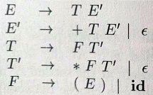
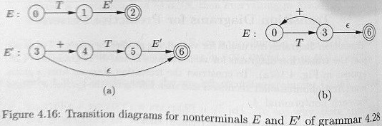
Transition Diagram for Productions

Slide 7
Predictive Parsing - Example
stmt → if ...... |
while ...... |
for .....
When replacing the non-terminal stmt with the right hand side, if the current token is if we choose first production, .
Predictive parsing: when replacing the non-terminal, we can uniquely choose the production by just looking at the current input token.
We eliminate the left recursion in the grammar, and left factor it. But it may still not be suitable for predictive parsing (not LL(1) grammar).

Slide 8
Recursive Predictive Parsing
For each non-terminal write a function call
For each terminal write a match statement.
Example: A → aBb (This is only the production rule for A)
A() {
- match the current token with a, and move to the next token;
- B();
- match the current token with b, and move to the next token;
}

Slide 9
Recursive Predictive Parsing (cont.)
Grammar: A → aBb | bAB
A()
{
switch(current token) {
case ‘a’: - match the current token with a, and move to the next token;
- B();
- match the current token with b, and move to the next token;
case ‘b’: - match the current token with b, and move to the next token;
- A();
- B();
}
}

Slide 10
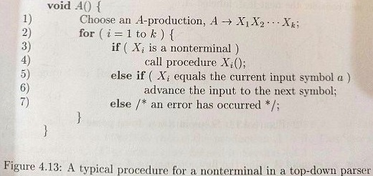

Slide 11
Recursive Predictive Parsing (cont.)
When to apply ε-productions.
Grammar: A → aA | bB | ε
If all other productions fail, we should apply an ε-production. For example, if the current token is not a neither b, we may apply the ε-production.
Most correct choice: We should apply an ε-production for a non-terminal A when the current token is in the follow set of A.
which terminals can follow A in the sentential forms
will discuss follow set in detail later.

Slide 12
Recursive Predictive Parsing (Example)
A → aBe | cBd | C B → bB | ε C → f
C() { match the current token with f,
A() { and move to the next token; }
switch (current token) {
case a: - match the current token with a,
and move to the next token; B() {
- B(); switch (current token) {
- match the current token with e, case b:- match the current token with b,
and move to the next token;
and move to the next token; - B ()
case e, d: do nothing
case c:- match the current token with c, }
and move to the next token; }
- B();
- match the current token with d,
and move to the next token;
case f: - C();
}
}
e, d, in follow set of B
f is in first set of C

Slide 13
Recursive Descent Parsing – Code Example
Grammar: S → Az | z A → xA | B B → y
void S() {
if (ch == ’z’)
ch = getchar();
else {
A();
if (ch == ’z’)
ch = getchar();
else
error("z expected");
}
cout << "Success!";
}
void A() {
if (ch == ’x’) {
ch = getchar();
A();
}
else B();
}
void B() {
if (ch == ’y’)
ch = getchar();
else
error("y expected");
}

Slide 14
Non-recursive Predictive Parsing
Non-Recursive predictive parser is a table-driven top-down parser.
It is also known as LL(1) Parser.
It contains an explicit stack, rather than implicitly via recursive calls.
The key problem is determining production to be applied for a non-terminal.

Slide 15
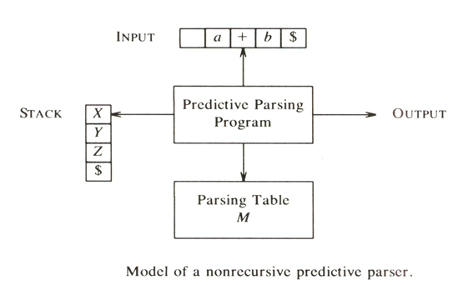
Model of LL(1) or Non-recursive Predictive Parser

Slide 16
LL(1) Parser
input buffer
Contains the string to be parsed. {assume it has end marker of $}
output
a production representing a step of the derivation sequence (left-most derivation) of the string in the input buffer.

Slide 17
LL(1) Parser
stack
contains the grammar symbols {i.e. terminals and non-terminals}
at the bottom of the stack, there is a special end marker symbol $.
initially the stack contains only the symbol $ and the starting symbol S. $S ⬅ initial stack
when the input is finished and stack is emptied, (i.e. only $ left in the stack), the parsing is complete.

Slide 18
LL(1) Parser
parsing table
a two-dimensional array PT [A, a] where
each row is a non-terminal symbol
each column is a terminal symbol or the special symbol $
each entry holds only single production of Grammar.

Slide 19
Non-recursive Predictive Parsing Algorithm
Where X = stack top symbol, a = current input symbol.
If X = a = $ then halt and announce success. (Accept)
If X = a ≠ $ then pop X off the stack and advance the input pointer (Match), If X ≠ a then error() (mismatch)
If X is non-terminal then consult parsing table PT. If PT[X,a] contains a production of the form X → α then pop X and replace it with the symbols in α with leftmost on top of stack. (e.g. X → WVU, with U on top)
If PT[X, a] is an error, or empty (no production in table) call error().

Slide 20
LL(1) Parsing Table – Example1
Grammar: S → aBa B → bB | ε
Parsing Table
 | A | B | $
S | S → aBa
B | B → ε | B → bB
{where S, B are non-terminals and a, b, $ are terminals}

Slide 21
LL(1) Parsing Table – Example1
Grammar:
S → aBa
B → bB | ε
 | a | b | $
S | S → aBa
B | B → ε | B → bB
parse tree
stack input output
$S abba$ S → aBa
$aBa abba$
$aB bba$ B → bB
$aBb bba$
$aB ba$ B → bB
$aBb ba$
$aB a$ B → ε
$a a$
$ $ accept, successful completion
S
a
B
a
b
B
b
B
ε
Leftmost Derivation: S ⇒ aBa ⇒ abBa ⇒ abbBa ⇒ abba

Slide 22
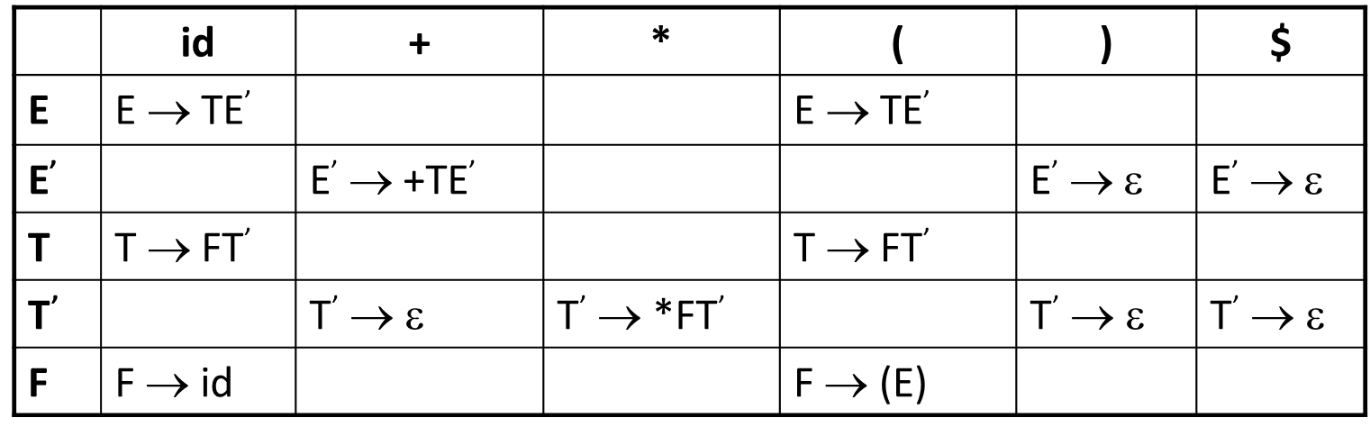
LL(1) Parser – Example2
Grammar:
E → TE’
E’ → +TE’ | ε
T → FT’
T’ → *FT’ | ε
F → (E) | id
Input:
id+id
Also check for input
id++
stack input output
$E id+id$ E → TE’
$E’T id+id$ T → FT’
$E’ T’F id+id$ F → id
$ E’ T’id id+id$
$ E’ T’ +id$ T’ → ε
$ E’ +id$ E’ → +TE’
$ E’ T+ +id$
$ E’ T id$ T → FT’
$ E’ T’ F id$ F → id
$ E’ T’id id$
$ E’ T’ $ T’ → ε
$ E’ $ E’ → ε
$ $ accept

Slide 23
LL(1) Parser – Example 3 (Exercise – Make its Parsing Table)
B → T B’
B’ → or T B’ | ε
T → F T’
T’ → and F T’ | ε
F → not F | ( B ) | true | false

Slide 24
Constructing LL(1) Parsing Tables
Two functions are used in the construction of LL(1) parsing tables:
FIRST
FOLLOW

Slide 25
Constructing LL(1) Parsing Tables
FIRST(α) is a set of the terminal symbols which occur as first symbols in all the strings derived from α (where α is any string of grammar symbols).
if α derives to ε (if α ⇒ ε) , then ε is also in FIRST(α) .
*

Slide 26
Compute FIRST for Any String X
If X is a terminal symbol
FIRST(X)={X}
If X is a non-terminal symbol and X → ε is a production rule
ε is in FIRST(X).
If X is ε
FIRST(X)={ε}

Slide 27
Compute FIRST for Any String X
If X is a non-terminal symbol and X → Y₁Y₂..Y_{n} is a production
if a terminal a is in FIRST(Y_{i}) and ε is in all FIRST(Y_{j}) for j=1,...,i-1
then put a in FIRST(X).
if ε is in all FIRST(Y_{j}) for j=1,...,n then put ε in FIRST(X).

Slide 28
FIRST Example
Grammar:
E → TE’
E’ → +TE’ | ε
T → FT’
T’ → *FT’ | ε
F → (E) | id
FIRST(F) = {(,id}
FIRST(T’) = {*, ε}
FIRST(T) = {(,id}
FIRST(E’) = {+, ε}
FIRST(E) = {(,id}

Slide 29
Constructing LL(1) Parsing Tables
FOLLOW(A) is the set of the terminals which occur immediately after (following) the non-terminal A in the strings derived from the starting symbol.
a terminal a is in FOLLOW(A) if S ⇒ αAaβ
$ is in FOLLOW(A) if S ⇒ αA
*
*

Slide 30
How to Compute FOLLOW (for non-terminals)
If S is the start symbol ➔ put $ is in FOLLOW(S)
if A → αBβ is a production ➔ put everything in FIRST(β) is in FOLLOW(B) except ε
If ( A → αB is a production ) or ( A → αBβ is a production and ε is in FIRST(β) ) ➔ put everything in FOLLOW(A) is in FOLLOW(B).
We apply these rules until nothing more can be added to any follow set.

Slide 31
FOLLOW Example
E → TE’
E’ → +TE’ | ε
T → FT’
T’ → *FT’ | ε
F → (E) | id
FOLLOW(E) = { $, ) }
FOLLOW(E’) = { $, ) }
FOLLOW(T) = { +, ), $ }
FOLLOW(T’) = { +, ), $ }
FOLLOW(F) = {+, *, ), $ }

Slide 32
Constructing LL(1) Parsing Table - Algorithm
for each production rule A → α of a grammar G do steps 2 and 3
Step 2 - for each terminal a in FIRST(α) ➔ add A → α to PT[A, a]
Step 3 – If ε in FIRST(α) ➔ for each terminal a in FOLLOW(A) add A → α to PT[A, a] If ε in FIRST(α) and $ in FOLLOW(A) ➔ add A → α to PT[A, $]
All other undefined entries of the parsing table are error entries.

Slide 33
Parsing Table
E → TE’
E’ → +TE’ | ε
T → FT’
T’ → *FT’ | ε
F → (E) | id
FIRST(F) = {(,id}
FIRST(T’) = {*, ε}
FIRST(T) = {(,id}
FIRST(E’) = {+, ε}
FIRST(E) = {(,id}
FOLLOW(E) = { $, ) }
FOLLOW(E’) = { $, ) }
FOLLOW(T) = { +, ), $ }
FOLLOW(T’) = { +, ), $ }
FOLLOW(F) = {+, *, ), $ }
for each production rule A → α of a grammar G do steps 2 and 3
Step 2 - for each terminal a in FIRST(α) ➔ add A → α to PT[A, a]
Step 3 – If ε in FIRST(α) ➔ for each terminal a in FOLLOW(A) add A → α to PT[A, a] If ε in FIRST(α) and $ in FOLLOW(A) ➔ add A → α to PT[A, $]
All other undefined entries of the parsing table are error entries.

Slide 34
Constructing LL(1) Parsing Table - Example
E → TE’ FIRST(TE’)={(,id} ➔ E → TE’ into PT[E,(] and PT[E, id]
E’ → +TE’ FIRST(+TE’ )={+} ➔ E’ → +TE’ into PT[E’,+]
E’ → ε FIRST(ε)={ε} ➔ none
but since ε is in FIRST(ε)
and FOLLOW(E’)={$,)} ➔ E’ → ε into PT[E’,$] and PT[E’,)]
T → FT’ FIRST(FT’)={(,id} ➔ T → FT’ into PT[T,(] and PT[T, id]
T’ → *FT’ FIRST(*FT’ )={*} ➔ T’ → *FT’ into PT[T’,*]
T’ → ε FIRST(ε)={ε} ➔ none
but since ε is in FIRST(ε)
and FOLLOW(T’)={$,),+} ➔ T’ → ε into PT[T’,$], PT[T’,)] and PT[T’,+]
F → (E) FIRST((E) )={(} ➔ F → (E) into PT[F,(]
F → id FIRST(id)={id} ➔ F → id into PT[F, id]

Slide 35
LL(1) Grammars
A grammar whose parsing table has no multiply-defined entries is said to be LL(1) grammar.
one input symbol used as a look-head symbol do determine parser action
LL(1) left most derivation
input scanned from left to right
The parsing table of a grammar may contain more than one production rule. In this case, we say that it is not a LL(1) grammar.

Slide 36
A Grammar which is not LL(1)
Grammar:
S → if C then S E | a
E → else S | ε
C → b
FIRST(S) = {if, a}
FIRST(E) = {else, ε}
FIRST(C) = {b}
FOLLOW(S) = { $, else }
FOLLOW(E) = { $, else }
FOLLOW(C) = { then }
 | a | b | E | i | t | $
S | S → a |  |  | S → if C then S E
E |  |  | E → else S E → ε |  |  | E → ε
C |  | C → b
two production rules for PT [E,e]
Problem ➔ ambiguity

Slide 37
A Grammar which is not LL(1) (cont.)
What do we have to do it if the resulting parsing table contains multiply defined entries?
If we didn’t eliminate left recursion, eliminate the left recursion in the grammar.
If the grammar is not left factored, we have to left factor the grammar.
If its (new grammar’s) parsing table still contains multiply defined entries, that grammar is ambiguous or it is inherently not a LL(1) grammar.
A left recursive grammar cannot be a LL(1) grammar.
A → Aα | β
any terminal that appears in FIRST(β) also appears FIRST(Aα) because Aα ⇒ βα.
If β is ε, any terminal that appears in FIRST(α) also appears in FIRST(Aα) and FOLLOW(A).
A grammar is not left factored, it cannot be a LL(1) grammar
A → αβ₁ | αβ₂
any terminal that appears in FIRST(αβ₁) also appears in FIRST(αβ₂).
An ambiguous grammar cannot be a LL(1) grammar.

Slide 38
Properties of LL(1) Grammars
A grammar G is LL(1) if and only if the following conditions hold for two distinctive production rules A → α and A → β
Both α and β cannot derive strings starting with same terminals.
At most one of α and β can derive to ε.
If β can derive to ε, then α cannot derive to any string starting with a terminal in FOLLOW(A).

Slide 39
Error Recovery in Predictive Parsing
An error may occur in the predictive parsing (LL(1) parsing)
if the terminal symbol on the top of stack does not match with the current input symbol.
if the top of stack is a non-terminal A, the current input symbol is a, and the parsing table entry PT[A, a] is empty.

Slide 40
Error Recovery in Predictive Parsing
What should the parser do in an error case?
The parser should be able to give an error message (as much as possible meaningful error message).
It should be recover from that error case, and it should be able to continue the parsing with the rest of the input.

Slide 41
Error Recovery Techniques
Panic-Mode Error Recovery
Skipping the input symbols until a synchronizing token is found.
Phrase-Level Error Recovery
Each empty entry in the parsing table is filled with a pointer to a specific error routine to take care that error case.

Slide 42
Error Recovery Techniques
Error-Productions
If we have a good idea of the common errors that might be encountered, we can augment the grammar with productions that generate erroneous constructs.
When an error production is used by the parser, we can generate appropriate error diagnostics.
Since it is almost impossible to know all the errors that can be made by the programmers, this method is not practical.

Slide 43
Error Recovery Techniques
Global-Correction
Ideally, we would like a compiler to make as few change as possible in processing incorrect inputs.
We have to globally analyze the input to find the error.
This is an expensive method, and it is not in practice.

Slide 44
Panic-Mode Error Recovery in LL(1) Parsing
In panic-mode error recovery, we skip all the input symbols until a synchronizing token is found.
What is the synchronizing token?
All the terminal-symbols in the follow set of a non-terminal can be used as a synchronizing token set for that non-terminal.

Slide 45
Panic-Mode Error Recovery in LL(1) Parsing
So, a simple panic-mode error recovery for the LL(1) parsing:
All the empty entries are marked as synch to indicate that the parser will skip all the input symbols until a symbol in the follow set of the non-terminal A which on the top of the stack. Then the parser will pop that non-terminal A from the stack. The parsing continues from that state.
To handle unmatched terminal symbols, the parser pops that unmatched terminal symbol from the stack and it issues an error message saying that that unmatched terminal is inserted.

Slide 46
Panic-Mode Error Recovery - Example
 | a | b | c | d | e | $
S | S → AbS | sync | S → AbS | sync | S → e | S → ε
A | A → a | sync | A → cAd | sync | sync | sync
S → AbS | e | ε
A → a | cAd
FOLLOW(S)={$}
FOLLOW(A)={b, d}
stack input output stack input output
$S aab$ S → AbS $S ceadb$ S → AbS
$SbA aab$ A → a $SbA ceadb$ A → cAd
$Sba aab$ $SbdAc ceadb$
$Sb ab$ Error: missing b, inserted $SbdA eadb$ Error:unexpected e (illegal A)
$S ab$ S → AbS (Remove all input tokens until first b or d, pop A)
$SbA ab$ A → a $Sbd db$
$Sba ab$ $Sb b$
$Sb b$ $S $ S → ε
$S $ S → ε $ $ accept
$ $ accept

Slide 47
Phrase-Level Error Recovery
Each empty entry in the parsing table is filled with a pointer to a special error routine which will take care that error case.
These error routines may:
change, insert, or delete input symbols.
issue appropriate error messages
pop items from the stack.
We should be careful when designing these error routines, because we may put the parser into an infinite loop.

